Slide 1

PROJECT ON
Hand Me Down Cars
SUBMITTED IN
PARTIAL FULFILLMENT OF THE REQUIREMENT
FOR THE COURSE OF DIPLOMA IN ADVANCED COMPUTING FROM CDAC
Institute Of Advance Computing And Software Development
Akurdi, Pune (M.H.)
Faculty Member
Mrs. Snehal Sapkal
External Guide
Mr. Chetan Pardeshi
SUBMITTED BY:
ANKIT PANDEY PRN : 210941220024

Slide 2
ACKNOWLEDGEMENT
A project usually falls short of its expectation unless aided and guided by the right persons at the right time. We avail this opportunity to express our deep sense of gratitude towards our internal guide Mrs. Snehal Sapkal and external guide Mr. Chetan Pardeshi.
We are deeply indebted and grateful to them for their guidance, encouragement and deep concern for our project. Without their critical evaluation and suggestions at every stage of the project, this project could never have reached its present form.
Last but not the least we thank the entire faculty and the staff members of Institute Of Advance Computing And Software Development, Akudi, Pune (M.H.), for their support.
ANKIT PANDEY PRN : 210941220024
PGDAC 21 Sept 2021
IACSD Akurdi, Pune (M.H.)

Slide 3
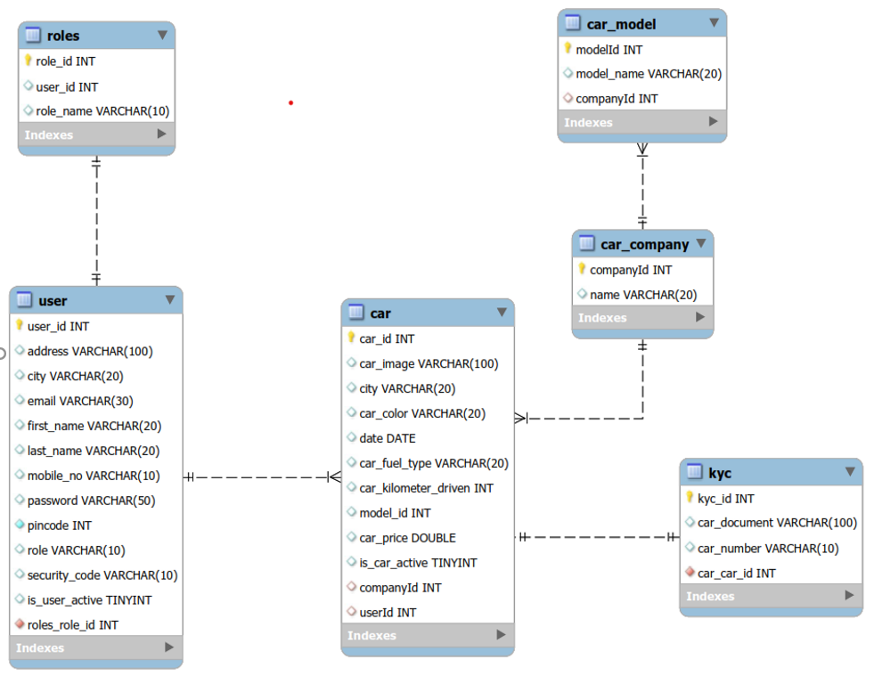
ERD :-

Slide 4
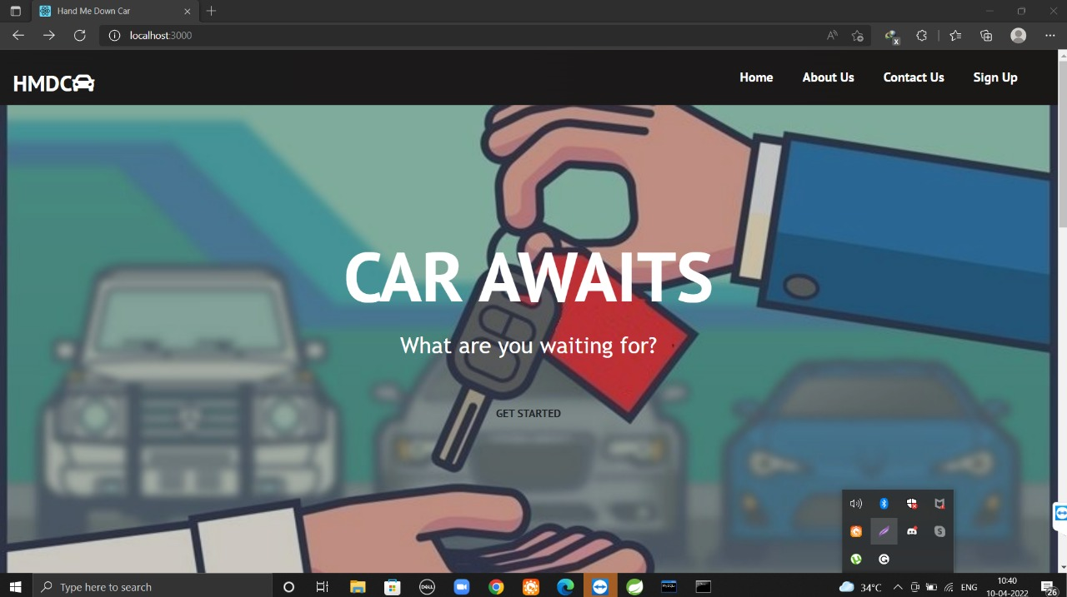
HOME PAGE

Slide 5
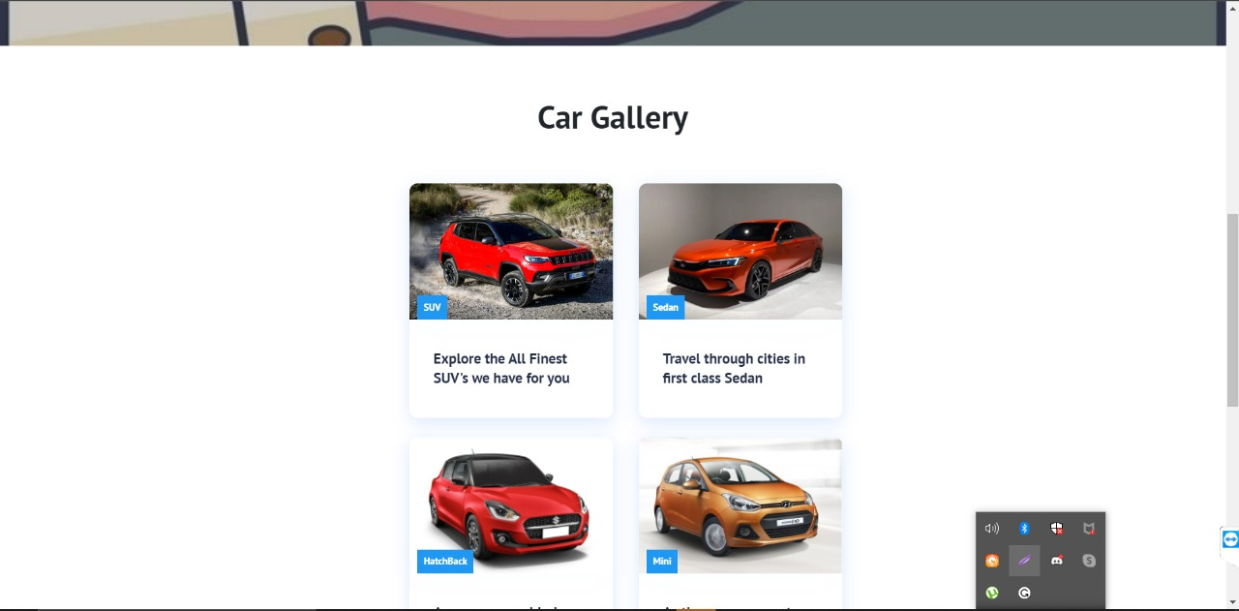

Slide 6
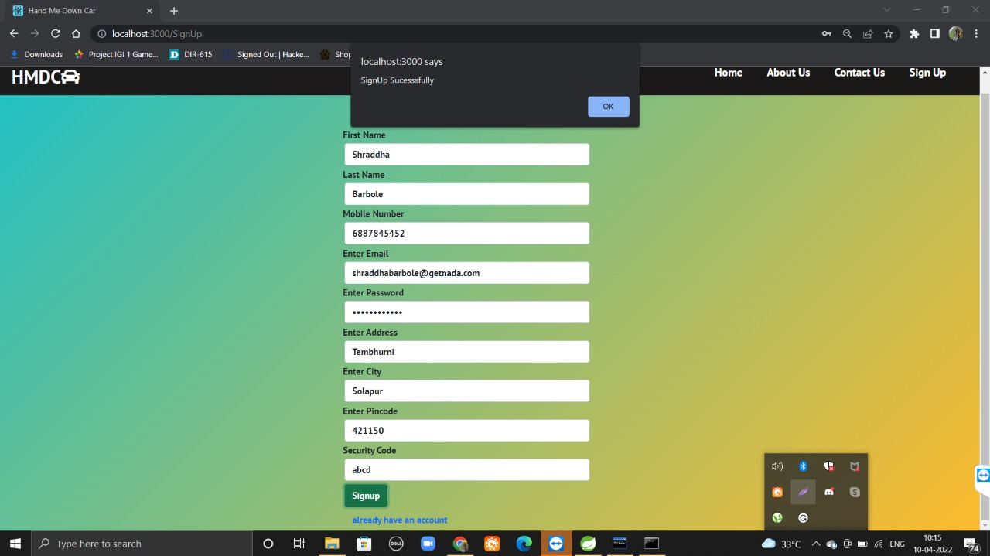

Slide 7
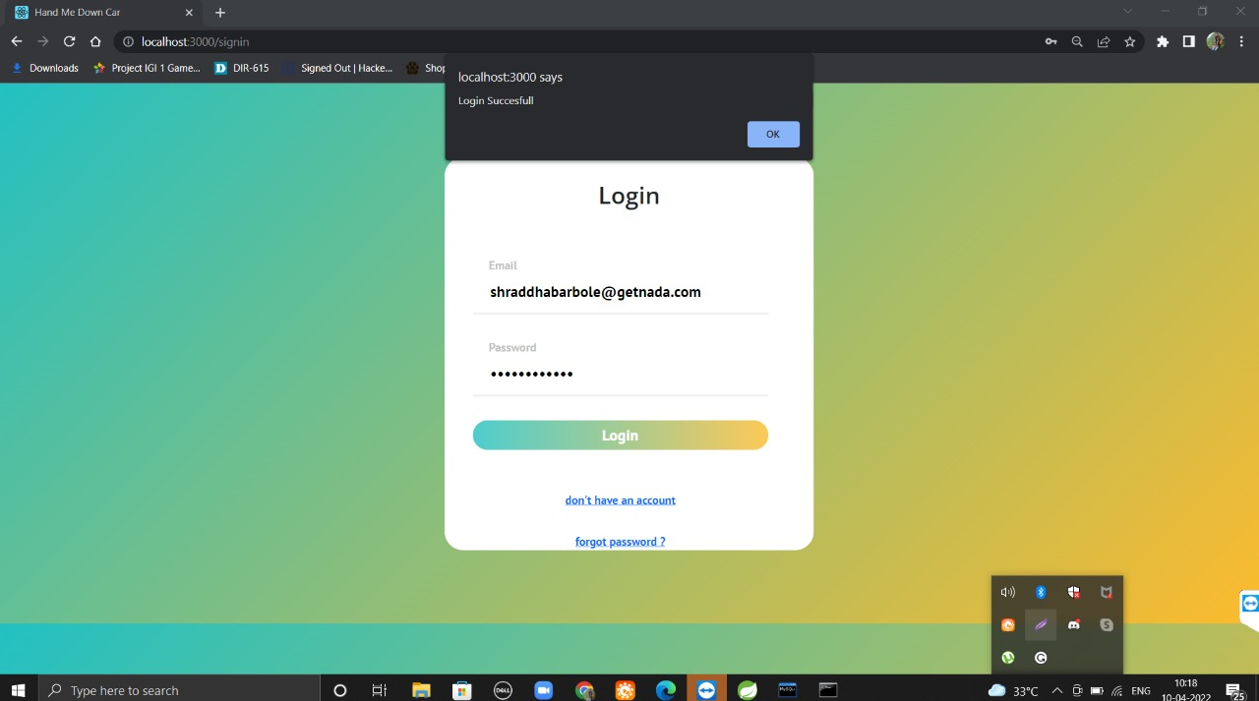

Slide 8
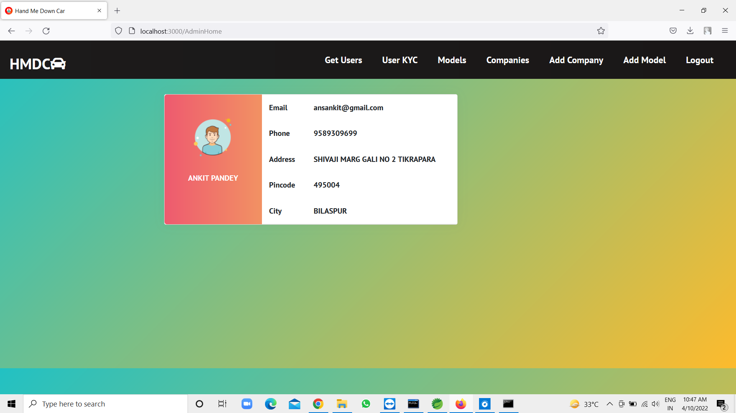

Slide 9
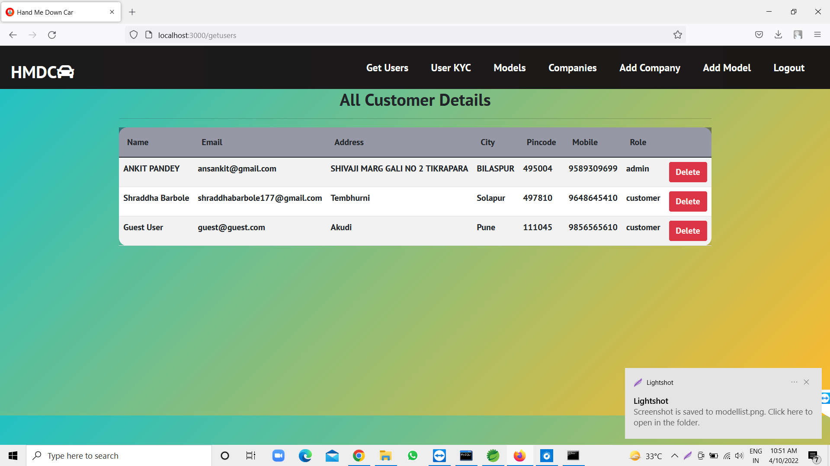

Slide 10
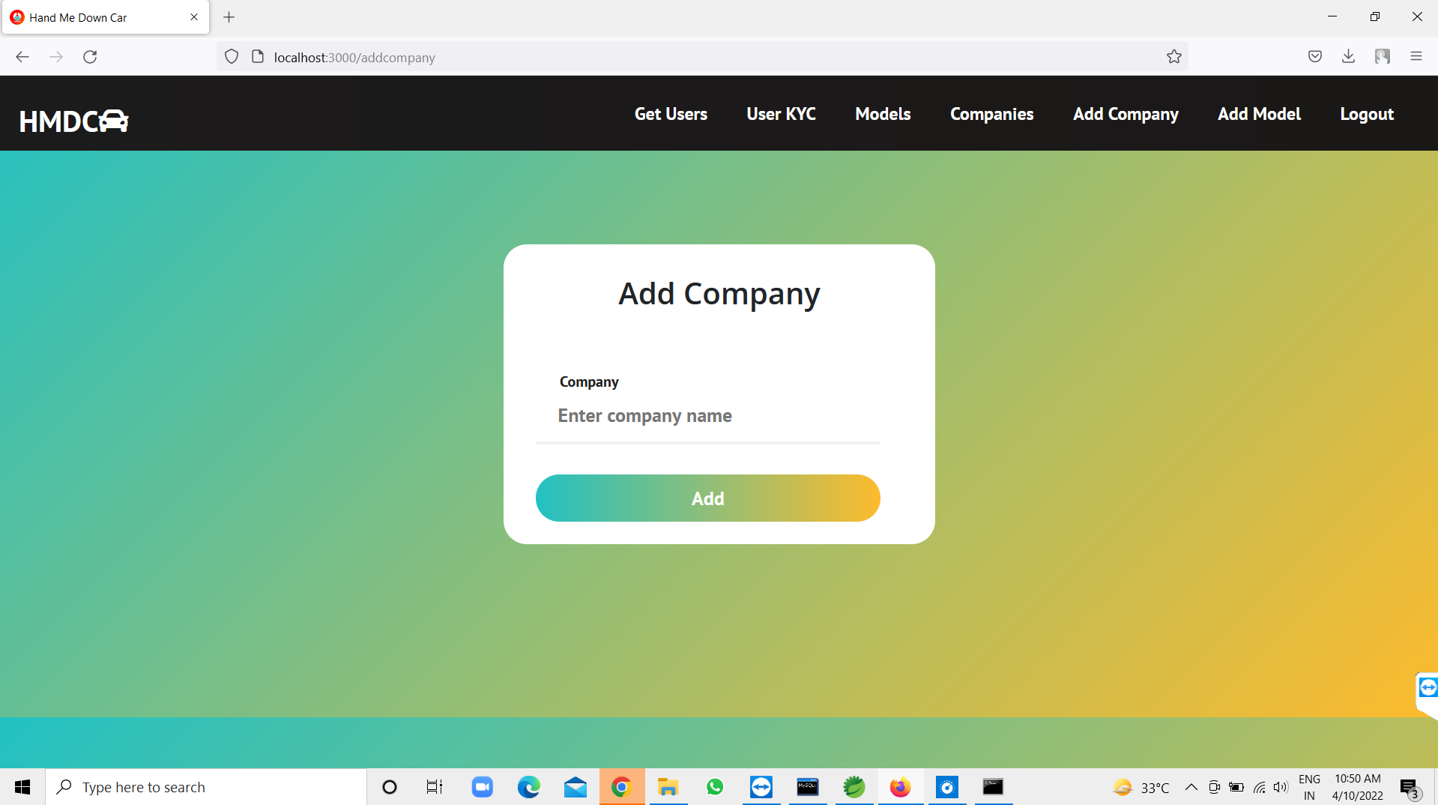

Slide 11
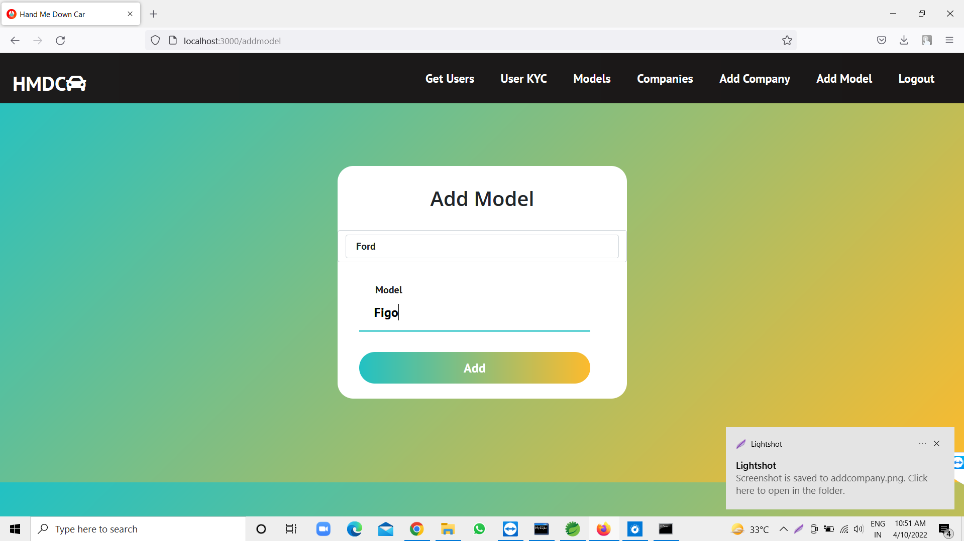

Slide 12
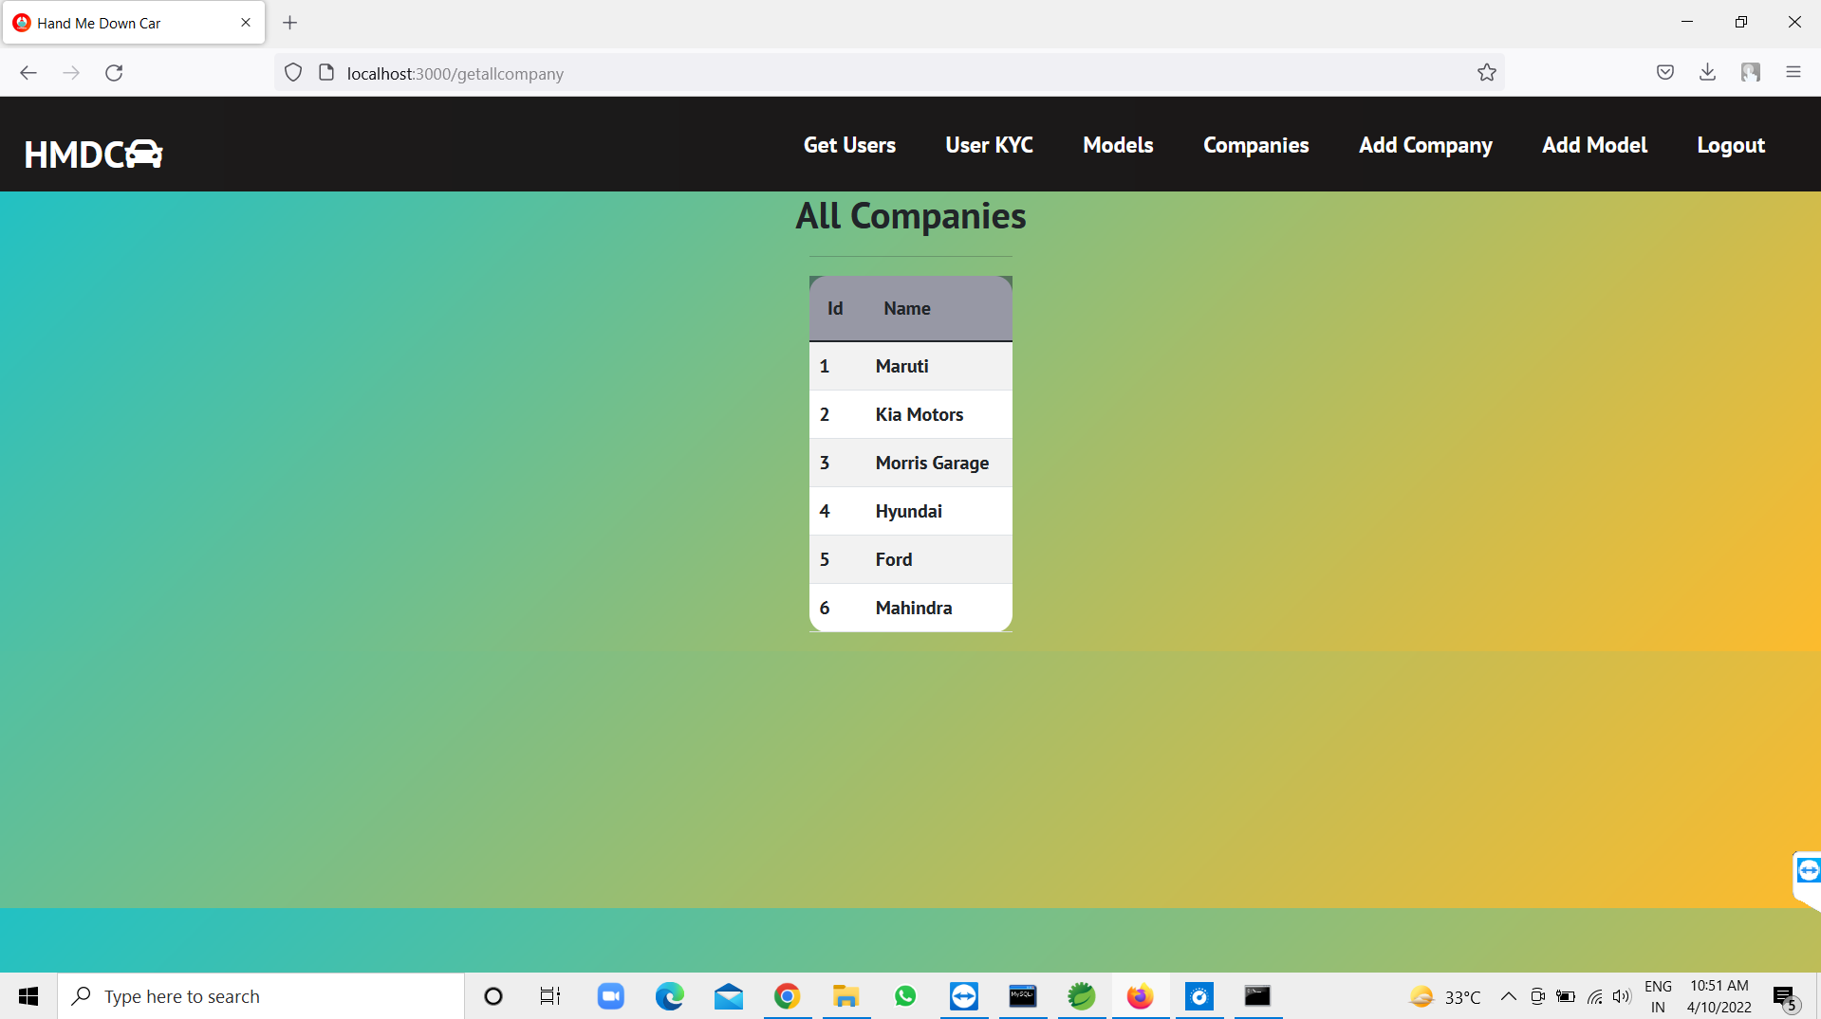

Slide 13
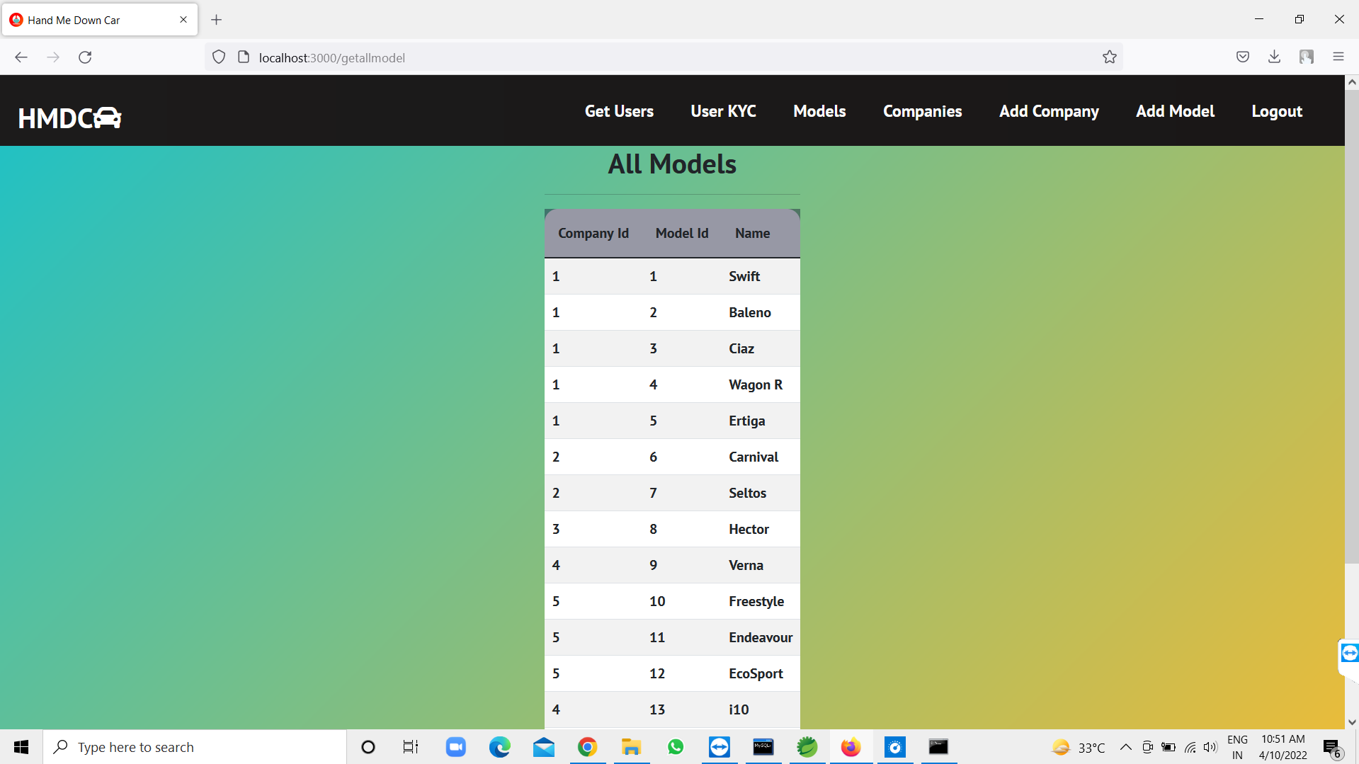

Slide 14
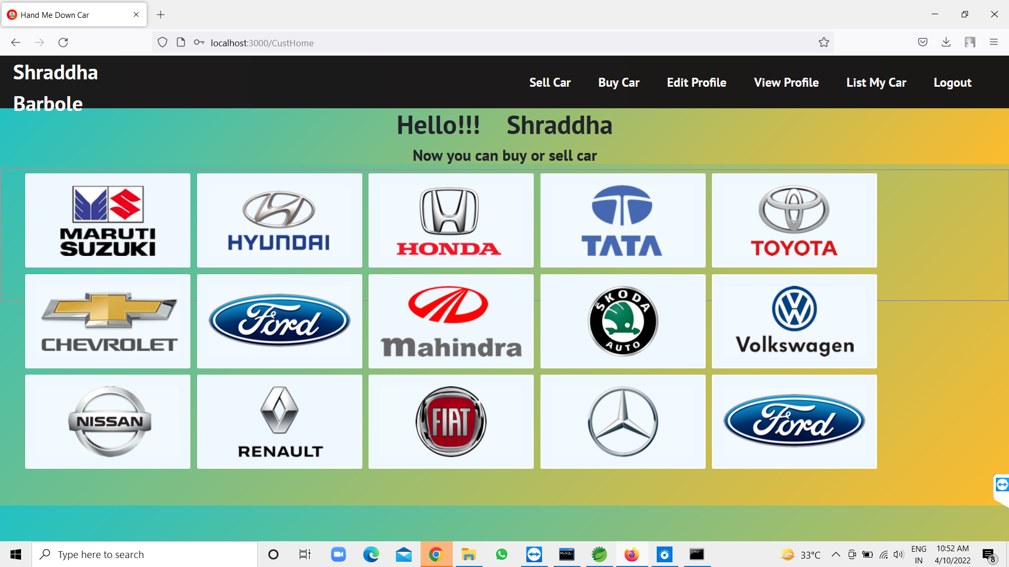

Slide 15
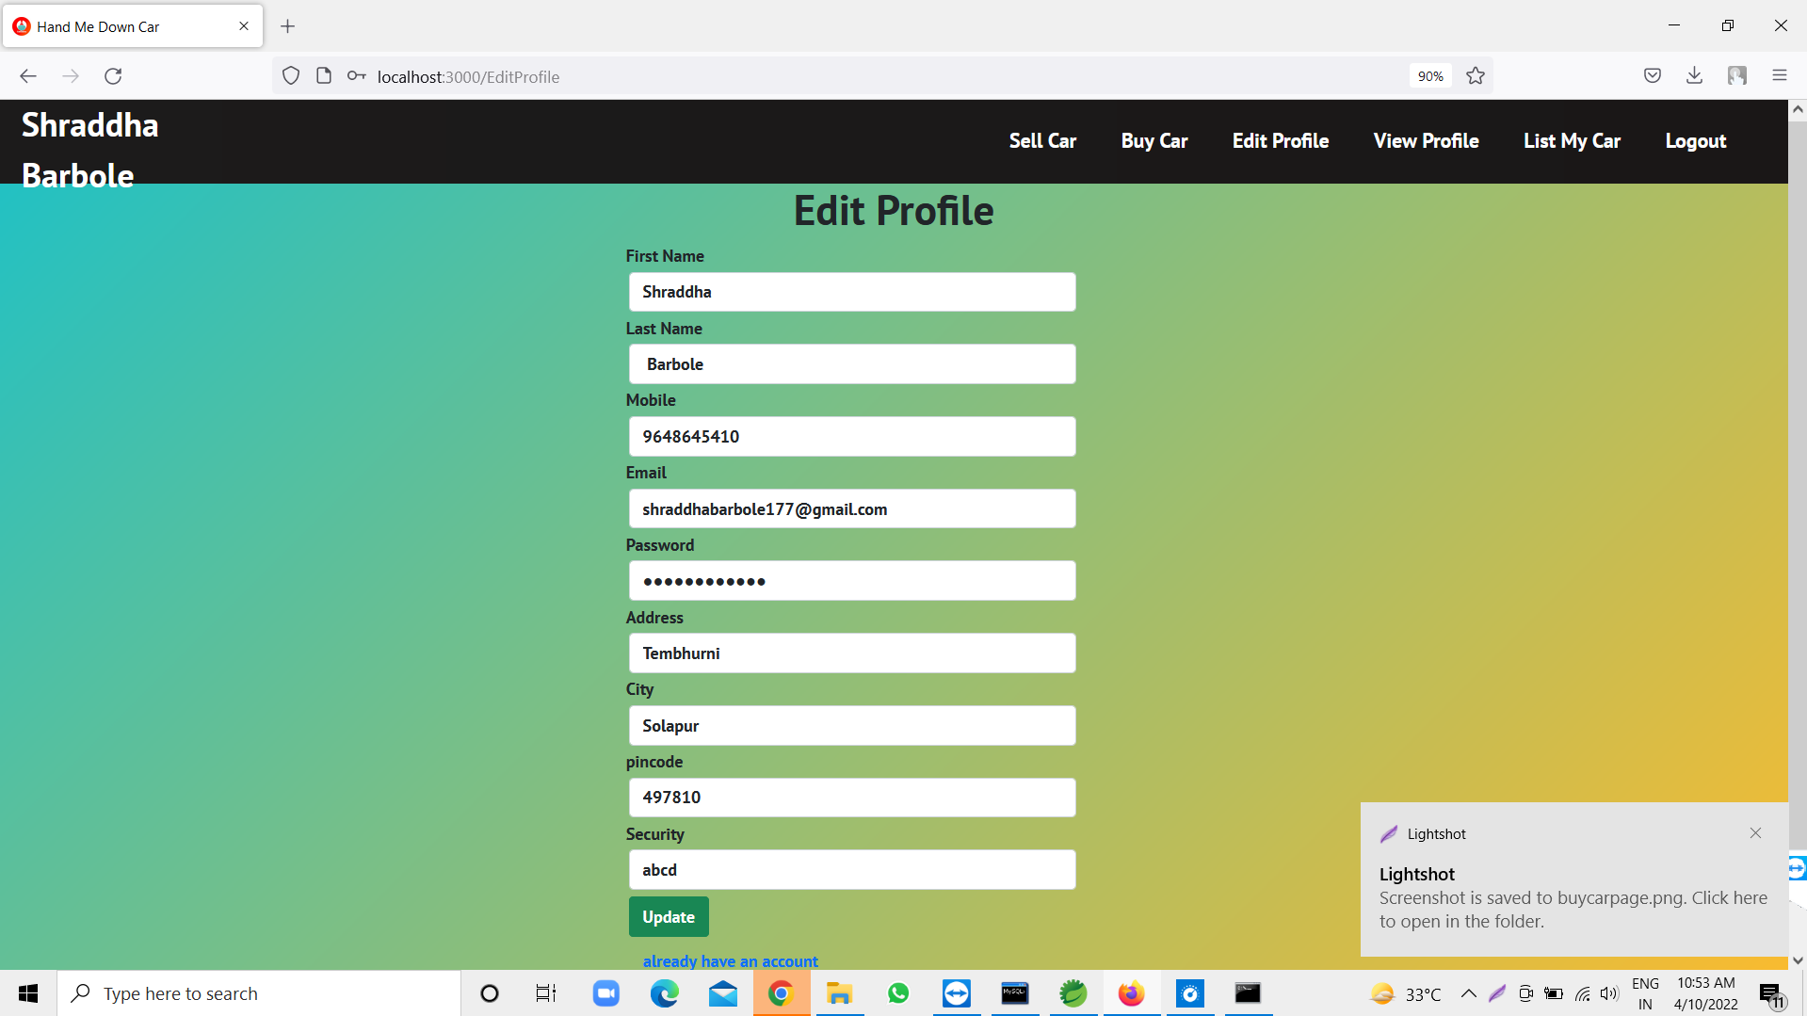

Slide 16
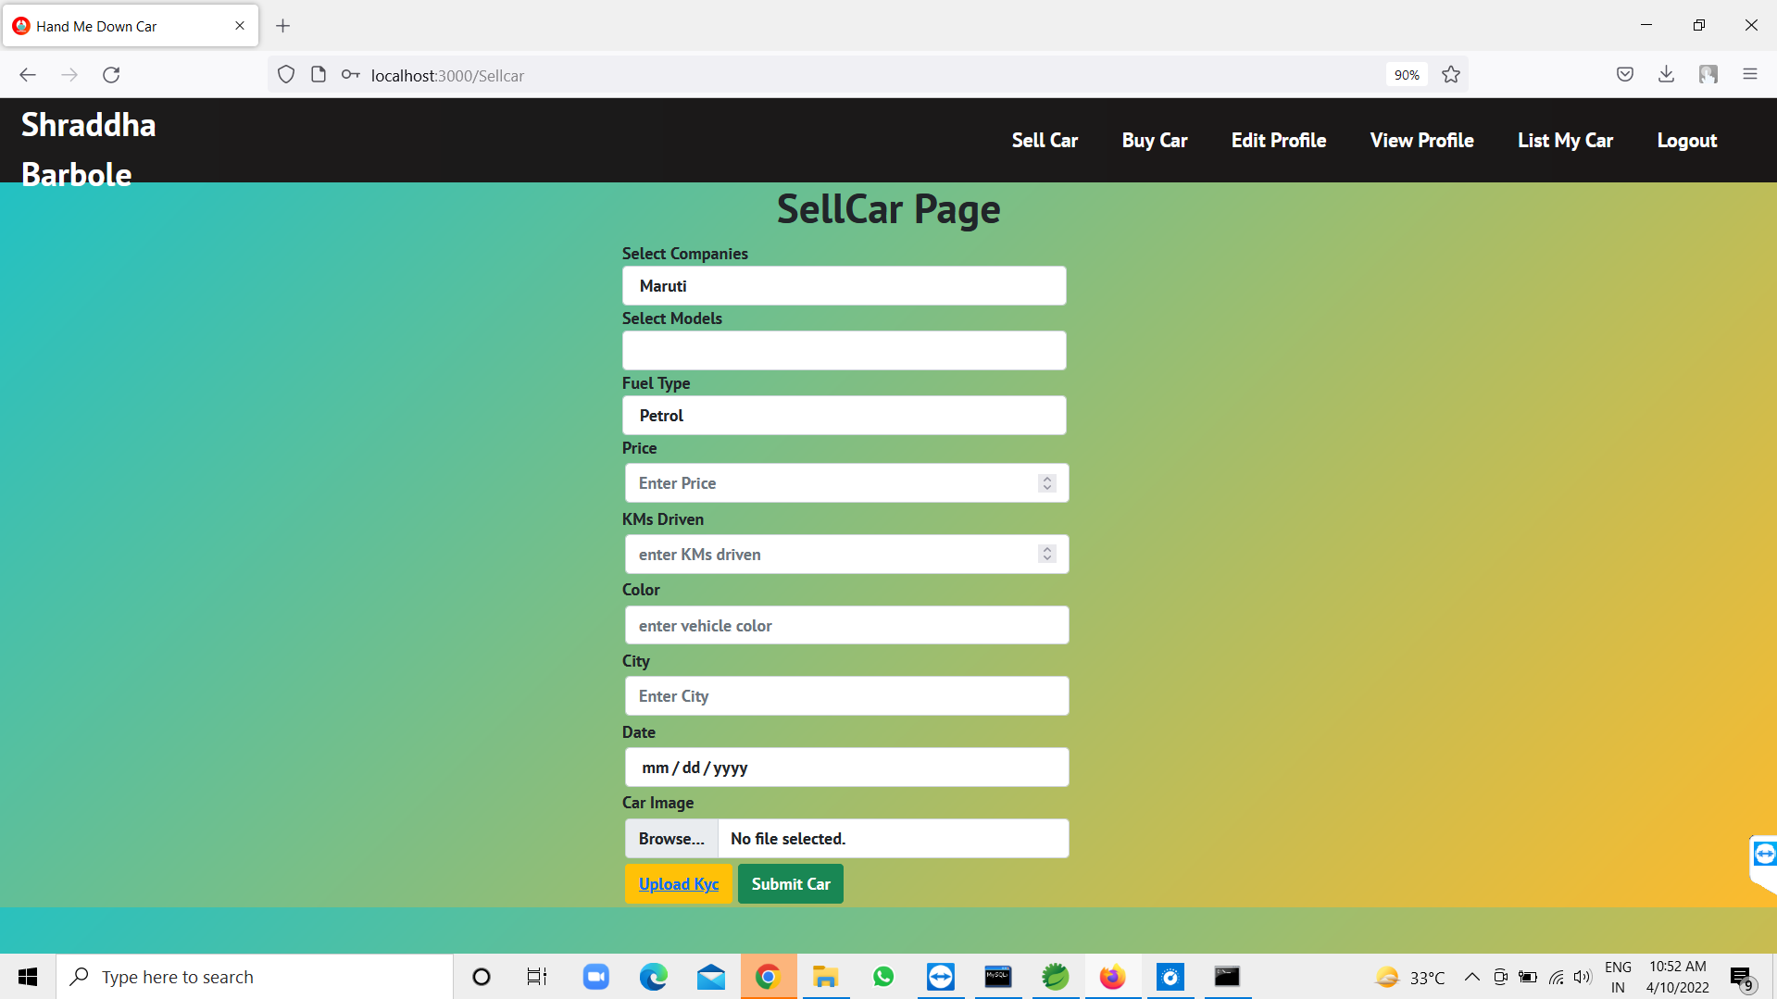

Slide 17
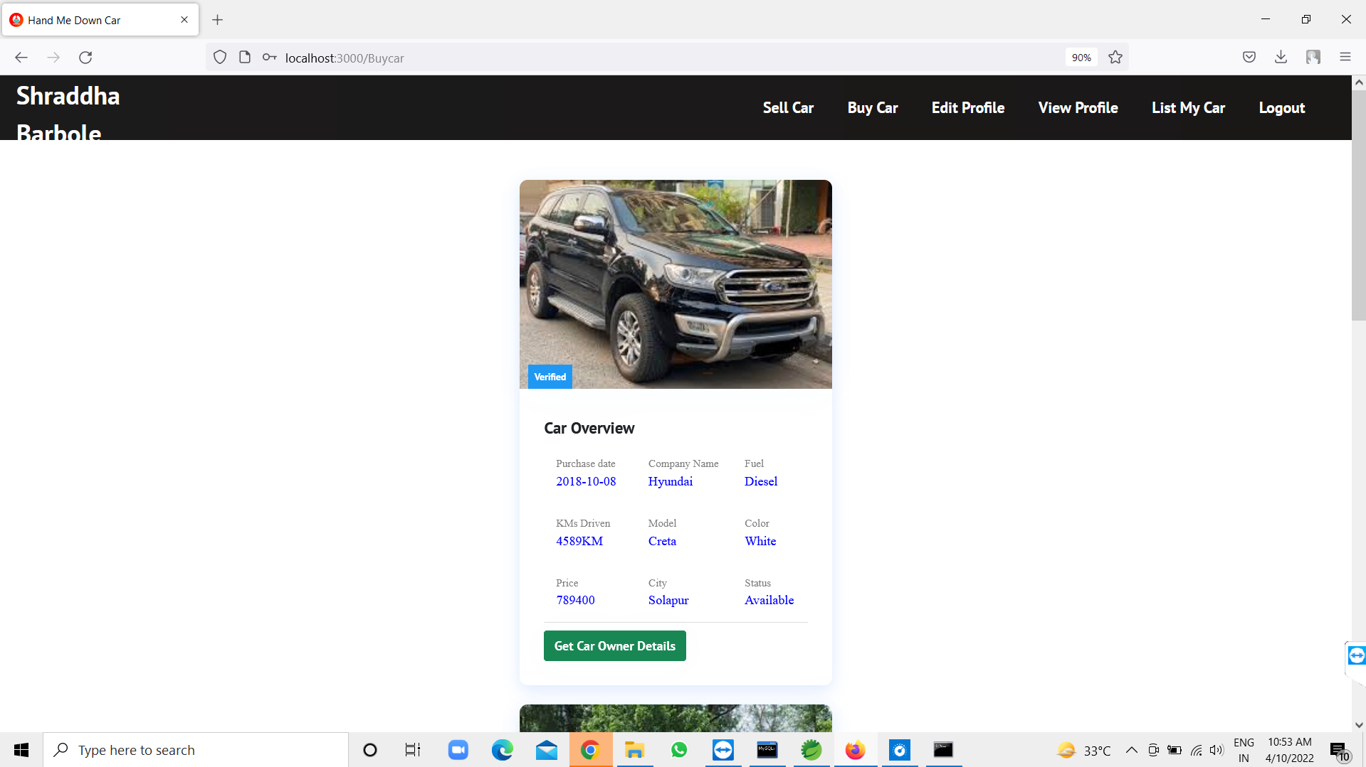

Slide 18
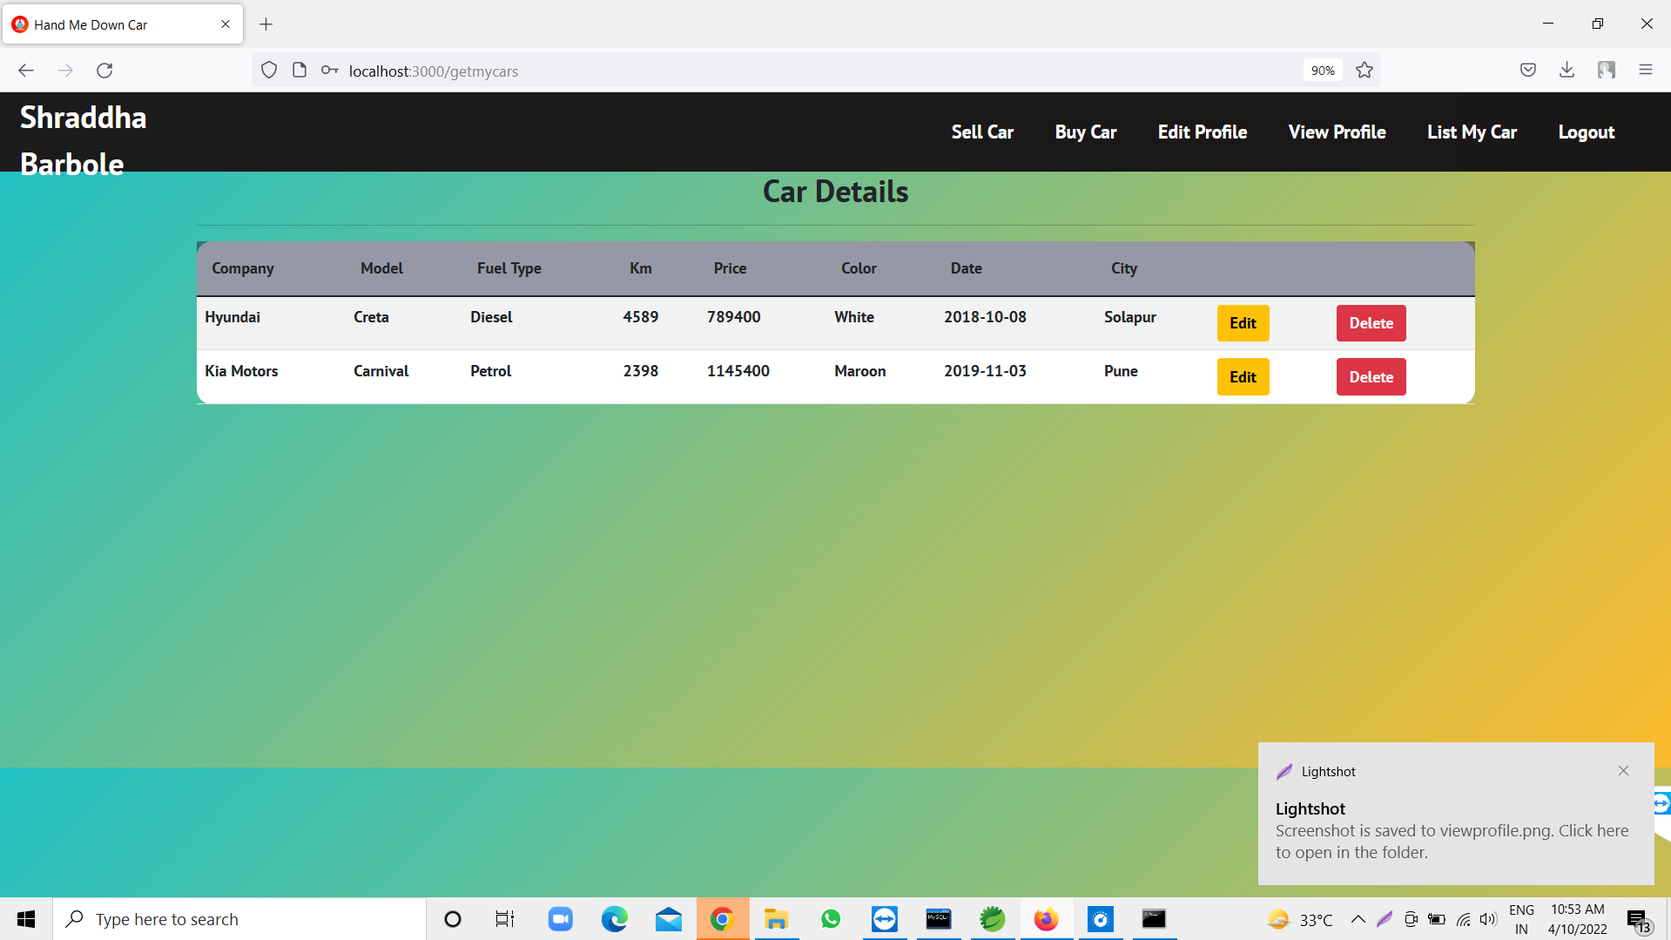

Slide 19
